Slide 1
Intermediate Macroeconomics Lesson 4 Balanced Growth Path
Fall 2025, LE HAVRE campus

Slide 2
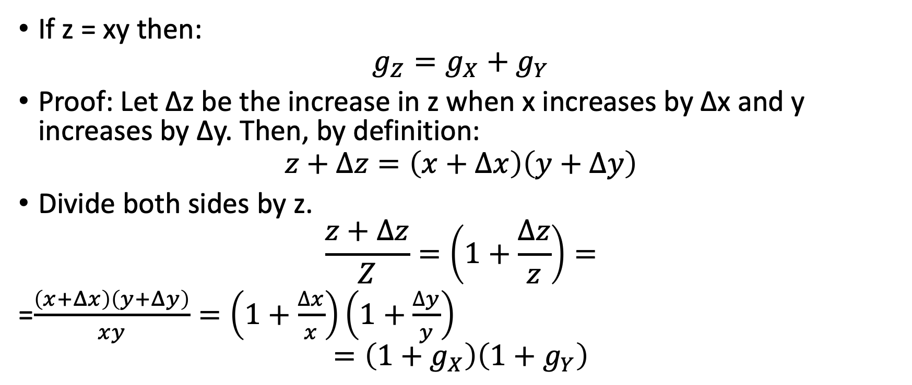
Logarithm Rule
If z = xy then:
$$g_{Z}=g_{X}+g_{Y}$$
Proof: Let ∆z be the increase in z when x increases by ∆x and y increases by ∆y. Then, by definition:
$$z+Δz=\left(x+Δx\right)\left(y+Δy\right)$$
Divide both sides by z.
$$\frac{z+Δz}{Z}=\left(1+\frac{∆z}{z}\right)=$$
=$\frac{\left(x+Δx\right)\left(y+Δy\right)}{xy}=\left(1+\frac{∆x}{x}\right)\left(1+\frac{∆y}{y}\right)$
$$=\left(1+g_{X}\right)\left(1+g_{Y}\right)$$

Slide 3
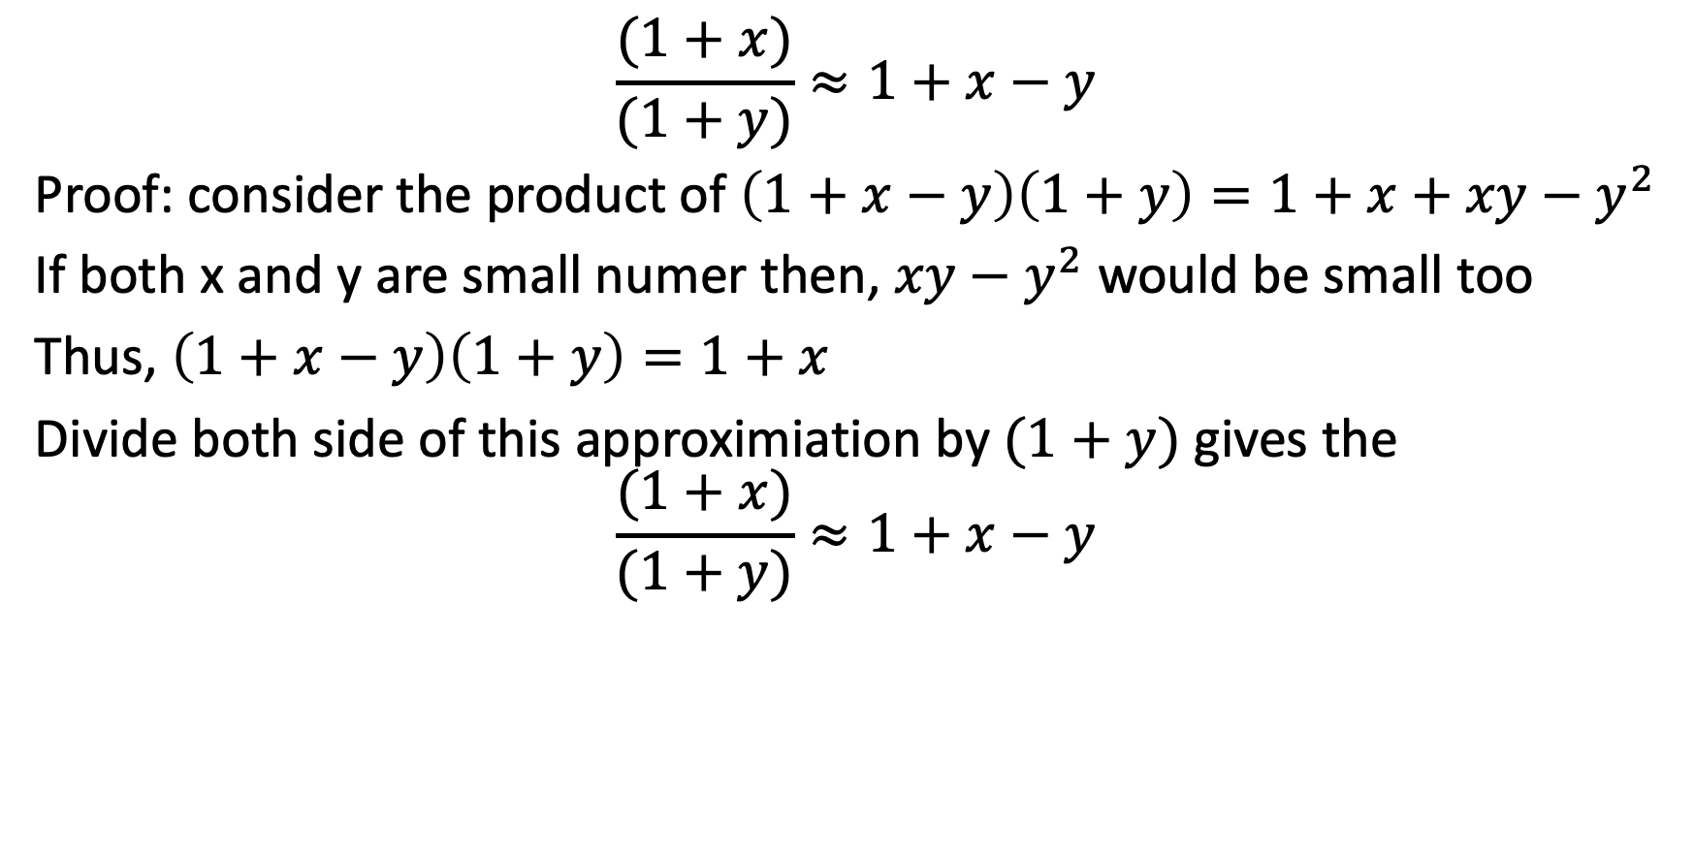
$$\frac{(1+x)}{(1+y)}≈1+x−y$$
Proof: consider the product of $\left(1+x−y\right)\left(1+y\right)=1+x+xy−y^{2}$
If both x and y are small numer then, $xy−y^{2}$ would be small too
Thus, $\left(1+x−y\right)\left(1+y\right)=1+x$
Divide both side of this approximiation by $(1+y)$ gives the
$$\frac{(1+x)}{(1+y)}≈1+x−y$$

Slide 4

$\left(1+g_{X}\right)\left(1+g_{Y}\right)=1+$ $g_{X}+g_{Y}$
Thus $1+\frac{∆z}{z}=(1+g_{Z})$
$$\left(1+g_{Z}\right)=1+ g_{X}+g_{Y}$$
$$\left(g_{Z}\right)= g_{X}+g_{Y}$$

Slide 5

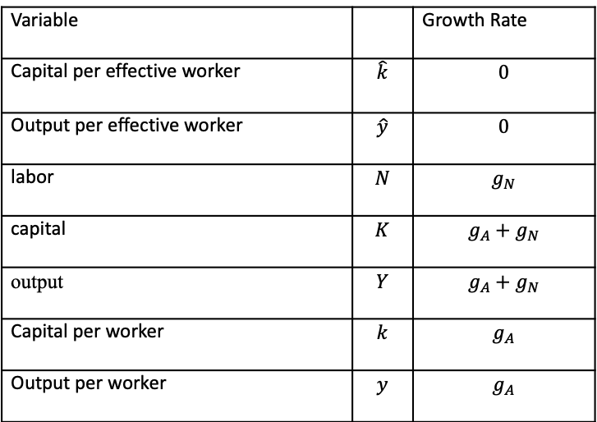
Characteristics of Balance of Growth Rate at Steady State
Variable |  | Growth Rate
Capital per effective worker | $$\hat{k}$$ | $$0$$
Output per effective worker | $$\hat{y}$$ | $$0$$
labor | $$N$$ | $$g_{N}$$
capital | $$K$$ | $$g_{A}+g_{N}$$
output | $$Y$$ | $$g_{A}+g_{N}$$
Capital per worker | $$k$$ | $$g_{A}$$
Output per worker | $$y$$ | $$g_{A}$$
On the balanced growth path (Steady state/long run)
$$∆\hat{k}=sf\left(\hat{k}\right)−\left(δ+g_{A}+g_{N}\right)\hat{k}=0$$

Slide 6
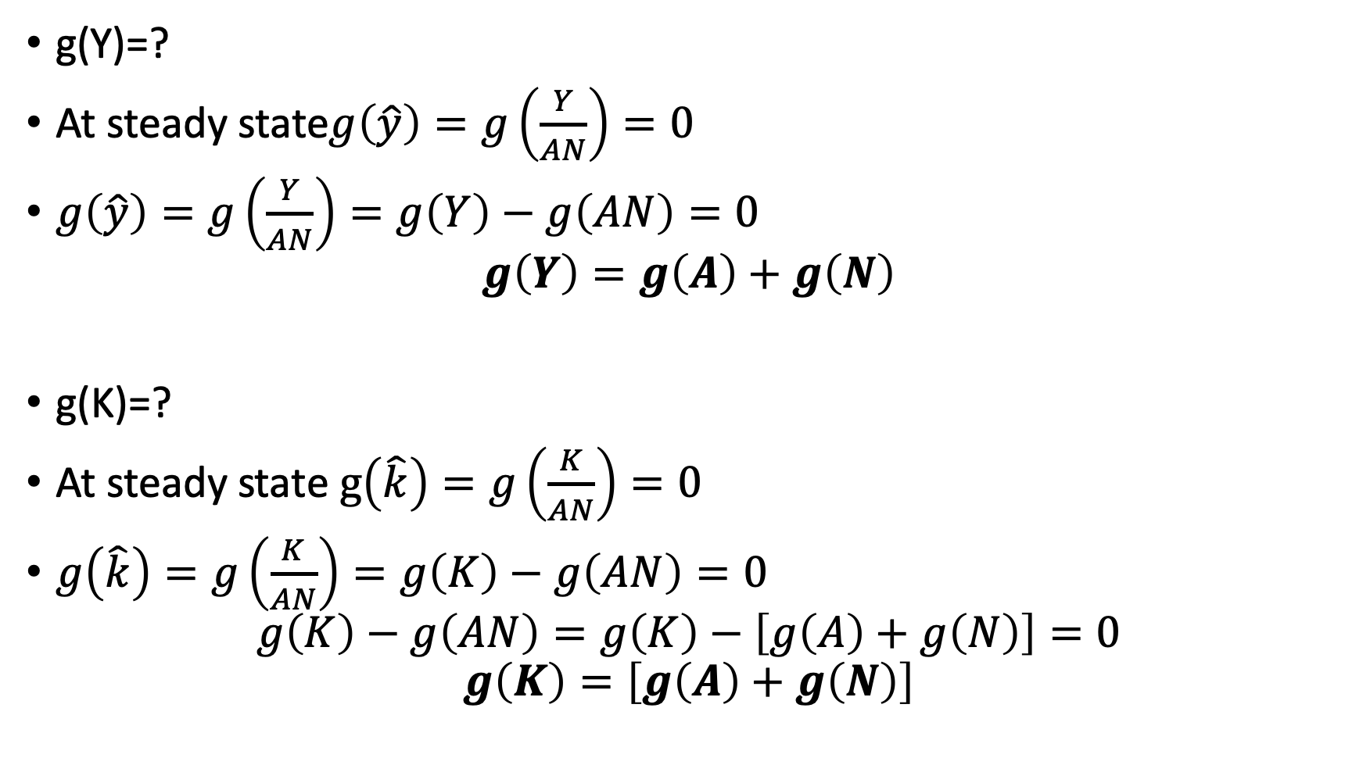
g(Y)=?
At steady state$g\left(\hat{y}\right)=g\left(\frac{Y}{AN}\right)=0$
$g\left(\hat{y}\right)=g\left(\frac{Y}{AN}\right)=g\left(Y\right)−g\left(AN\right)=0$
$$g\left(Y\right)=g\left(A\right)+g\left(N\right)$$
g(K)=?
At steady state $g\left(\hat{k}\right)=g\left(\frac{K}{AN}\right)=0$
$g\left(\hat{k}\right)=g\left(\frac{K}{AN}\right)=g\left(K\right)−g\left(AN\right)=0$
$$g\left(K\right)−g\left(AN\right)=g\left(K\right)−\left[g\left(A\right)+g\left(N\right)\right]=0$$
$$g\left(K\right)=\left[g\left(A\right)+g\left(N\right)\right]$$

Slide 7
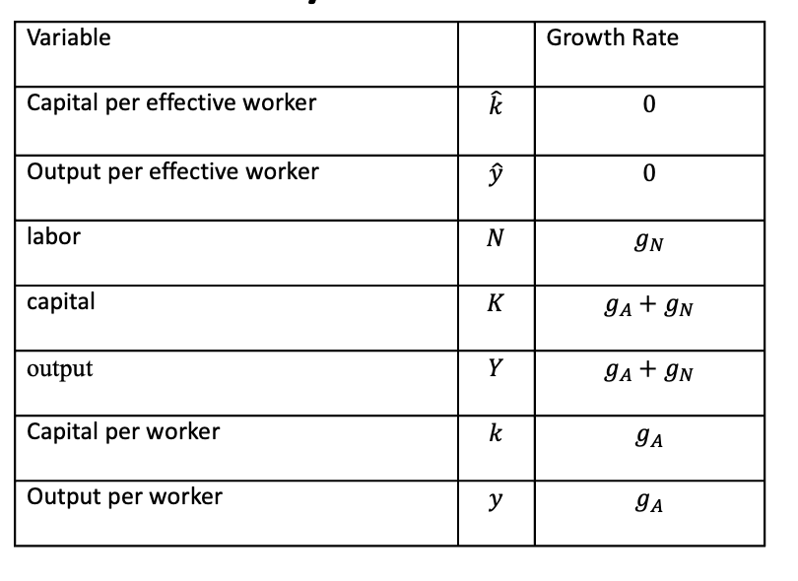

g(y)=?
$g\left(y\right)=g\left(\frac{Y}{N}\right)=g\left(Y\right)−g\left(N\right)=\left\{g\left(A\right)+g\left(N\right)\right\}−g\left(N\right)=g\left(A\right)$
g(k)=?

Slide 8
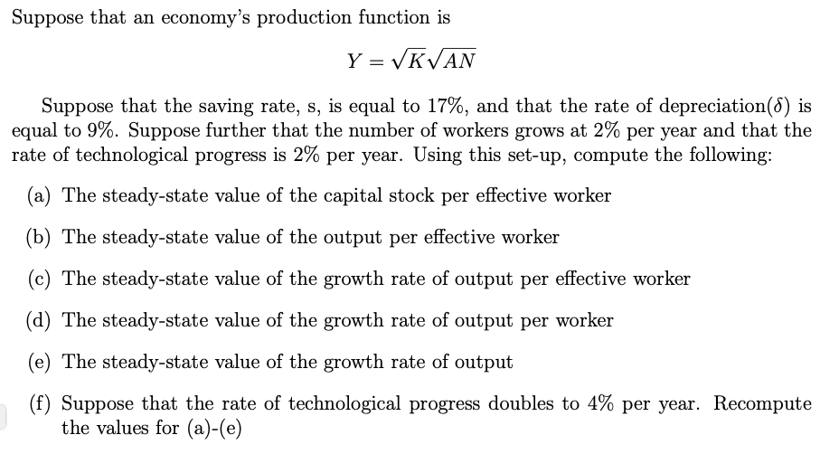
Example Problem for Problem Set 2

Slide 9

Q(a):
$$Y=\sqrt{K}\sqrt{AN}$$
$$\frac{Y}{AN}=\sqrt{\frac{K}{AN}}\sqrt{\frac{AN}{AN}}=\sqrt{\frac{K}{AN}}$$
$\hat{y}=\sqrt{\hat{k}}$
At steady-state, $∆\hat{k}=sf\left(\hat{k}\right)−\left(δ+g_{A}+g_{N}\right)\hat{k}=0$
$$sf\left(\hat{k}\right)=\left(δ+g_{A}+g_{N}\right)\hat{k}$$
$$0.17∗\sqrt{\hat{k}}=\left(0.09+0.02+0.02\right)\hat{k}$$
$$0.17∗\sqrt{\hat{k}}=\left(0.13\right)\hat{k}$$
$$\frac{0.17}{0.13}=\hat{\frac{k}{\sqrt{\hat{k}}}}$$
$${\left(1.307\right)}^{2}={\left(\frac{\hat{k}}{\sqrt{\hat{k}}}\right)}^{2}$$
$$\hat{k}=1.71$$
$${\hat{k}}^{∗}=1.71$$

Slide 10

Q (b)
$${\hat{y}}^{∗}=\sqrt{{\hat{k}}^{∗}}=1.307$$

Slide 11
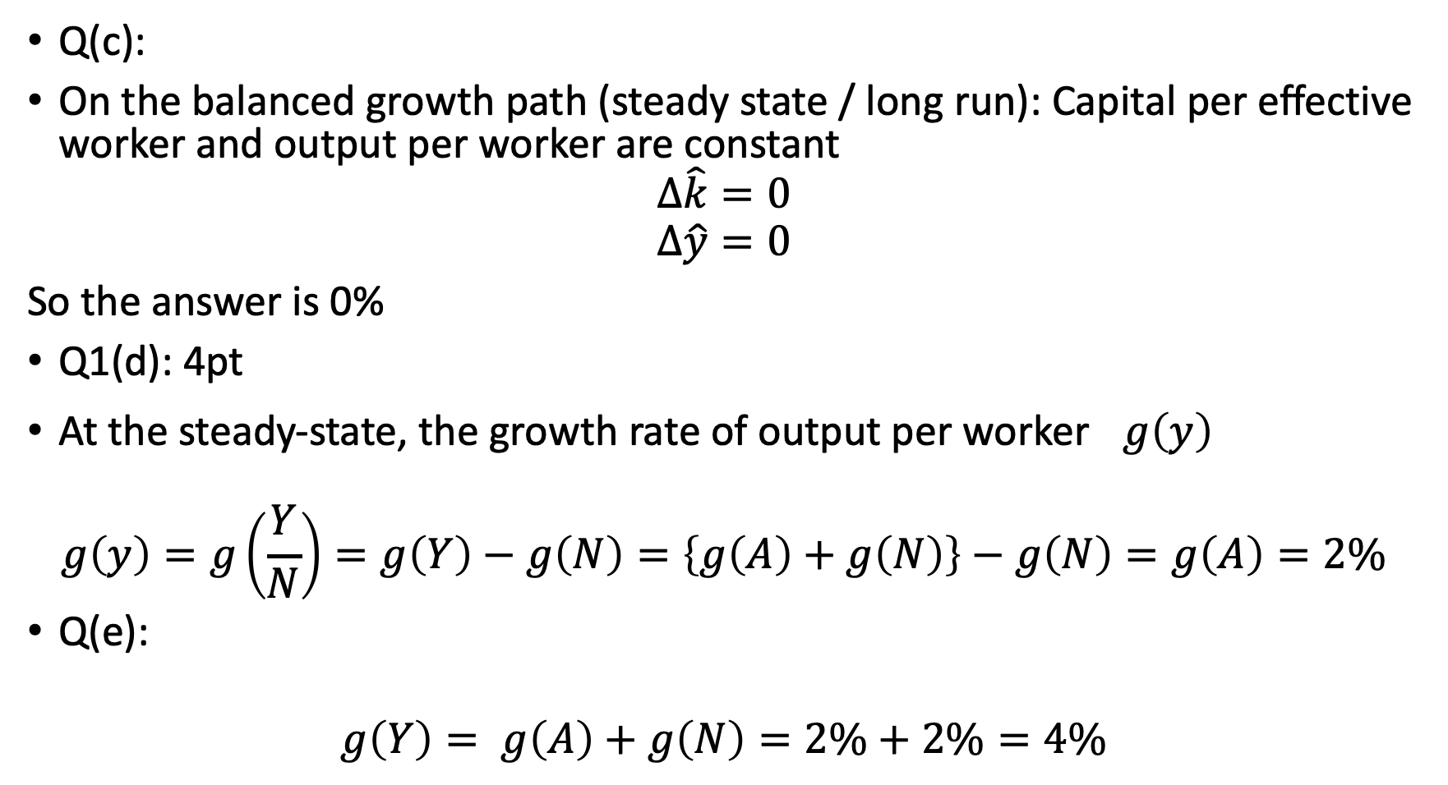
Q(c):
On the balanced growth path (steady state / long run): Capital per effective worker and output per worker are constant
$$Δ\hat{k}=0$$
$$Δ\hat{y}=0$$
So the answer is 0%
Q1(d): 4pt
At the steady-state, the growth rate of output per worker $g\left(y\right)$
$$g\left(y\right)=g\left(\frac{Y}{N}\right)=g\left(Y\right)−g\left(N\right)=\left\{g\left(A\right)+g\left(N\right)\right\}−g\left(N\right)=g\left(A\right)=2\%$$
Q(e):
$$g\left(Y\right)= g\left(A\right)+g\left(N\right)=2\%+2\%=4\%$$

Slide 12

$Δ\hat{y}=0$; $g\left(\hat{y}\right)=0$ from Q1(c):
$$g\left(\hat{y}\right)=g\left(\frac{Y}{AN}\right)= g\left(Y\right)−g\left(AN\right)=g\left(Y\right)−\left\{g\left(A\right)+g\left(N\right)\right\}=0$$
$$g\left(Y\right)=\left\{g\left(A\right)+g\left(N\right)\right\}$$

Slide 13

Q(f)
Change the g(A) from 2% to 4% and do it again from (a) to (e)
$$Y=\sqrt{K}\sqrt{AN}$$
$$\frac{Y}{AN}=\sqrt{\frac{K}{AN}}\sqrt{\frac{AN}{AN}}=\sqrt{\frac{K}{AN}}$$
$$\hat{y}=\sqrt{\hat{k}}$$
At steady-state, $∆\hat{k}=sf\left(\hat{k}\right)−\left(δ+g_{A}+g_{N}\right)\hat{k}=0$
$$sf\left(\hat{k}\right)=\left(δ+g_{A}+g_{N}\right)\hat{k}$$
$$0.17∗\sqrt{\hat{k}}=\left(0.09+0.04+0.02\right)\hat{k}$$
$$0.17∗\sqrt{\hat{k}}=\left(0.15\right)\hat{k}$$
$$\frac{0.17}{0.15}=\hat{\frac{k}{\sqrt{\hat{k}}}}$$
$${\left(1.3333\right)}^{2}={\left(\frac{\hat{k}}{\sqrt{\hat{k}}}\right)}^{2}$$
$$\hat{k}=1.28$$
${\hat{k}}^{∗}=1.28$
${\hat{y}}^{∗}=\sqrt{{\hat{k}}^{∗}}=1.13$

Slide 14
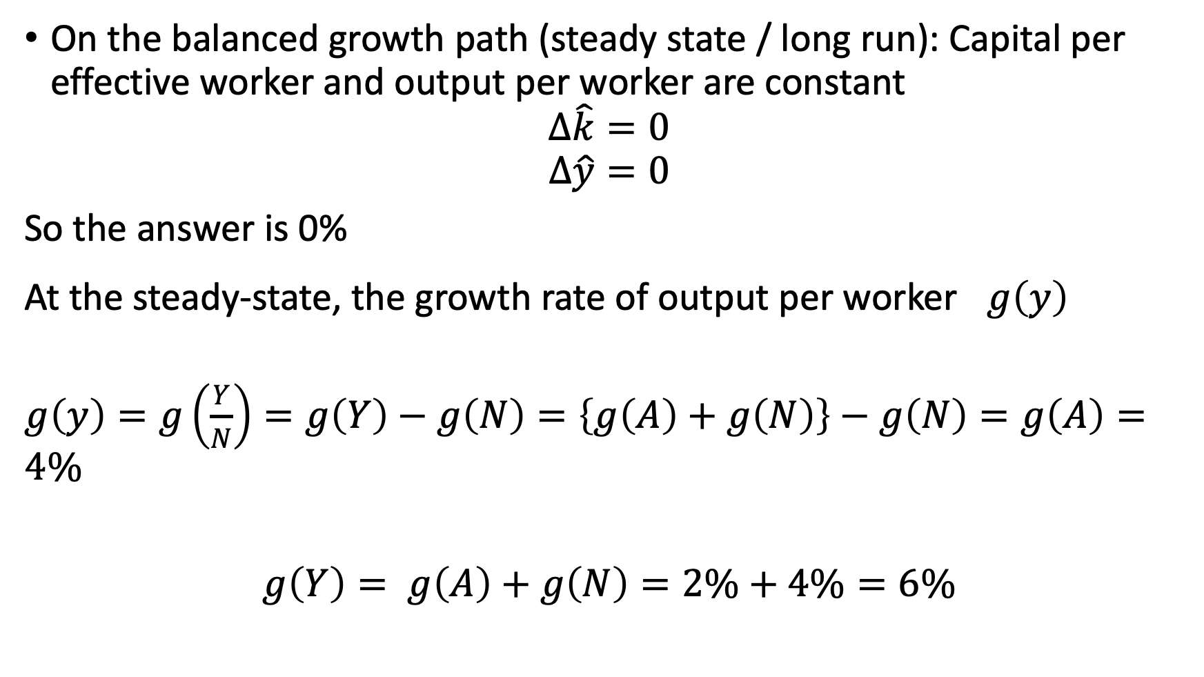
On the balanced growth path (steady state / long run): Capital per effective worker and output per worker are constant
$$Δ\hat{k}=0$$
$$Δ\hat{y}=0$$
So the answer is 0%
At the steady-state, the growth rate of output per worker $g\left(y\right)$
$g\left(y\right)=g\left(\frac{Y}{N}\right)=g\left(Y\right)−g\left(N\right)=\left\{g\left(A\right)+g\left(N\right)\right\}−g\left(N\right)=g\left(A\right)=4\%$
$g\left(Y\right)= g\left(A\right)+g\left(N\right)=2\%+4\%=6\%$

Slide 15
How to plot a graph on Excel
Let’s work on how to show the Solow residual as a data exercise!
Please go to the data in the section of the Moodle Lesson 4

